Slide 1
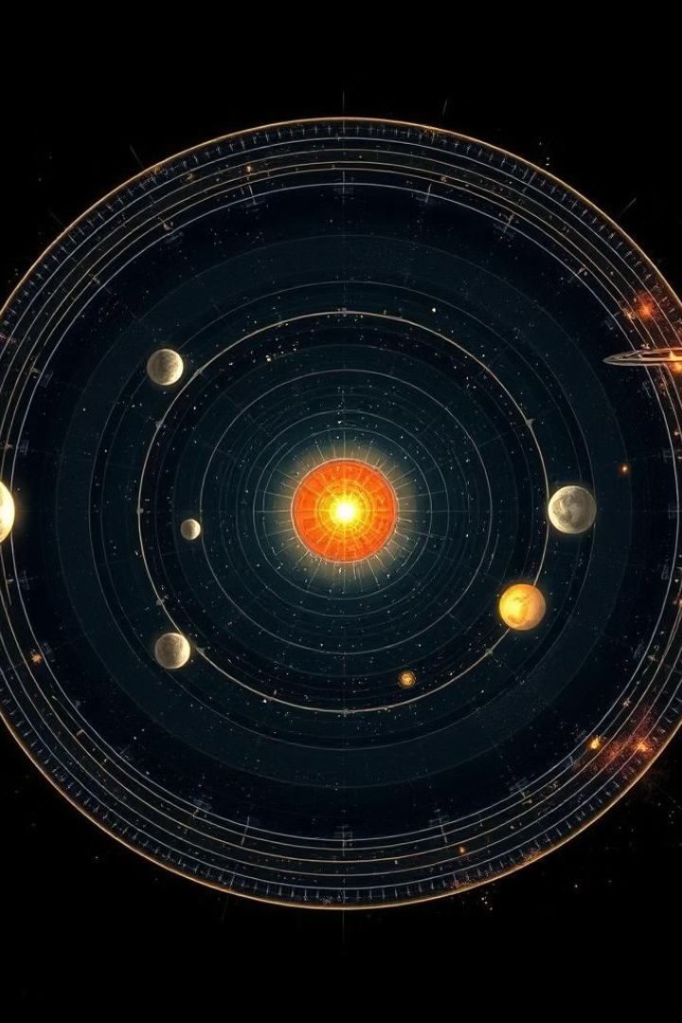
Team Members
Sadia Khan
Memona

Slide 2
Team Name
OrbitXplorers
Challenge
Create an Orrery Web App that displays Near Earth Object

Slide 3
User Experience
Intuitive Navigation
Interactive Design
Responsive Design
Interactive ToolTips
Educational Content

Slide 4

Navigating the Orrery
Zoom and Pan
Detailed Information
Adjust the view to focus on specific regions of the orrery and get a closer look at celestial objects.
Click on any NEO to access its orbital details, physical properties, and potential hazard assessments.
1
2
3
Filter and Search
Easily find and explore individual Near-Earth Objects using the comprehensive search function.
Orrery-Solar-System

Slide 5
How NASA Data Helped us?
Understanding Orbits
Keplerian Principles
Orbital Parameters
OrbitXplorer applies Kepler's laws of planetary motion to accurately plot the orbits of Near-Earth Objects, who’s description and important method are extracted from NASA
Users can explore the semi-major axis, eccentricity, inclination, and other key orbital characteristics of NEOs. All these parameter are extracted from the NASA API’s for NEA & NEC
Orrery-Solar-System

Slide 6
Understanding Orbits
Keplerian Principles
Orbital Parameters
NEO Position
OrbitXplorer applies Kepler's laws of planetary motion to accurately plot the orbits of Near-Earth Objects.
Users can explore the semi-major axis, eccentricity, inclination, and other key orbital characteristics of NEOs.
The app to identify the position of object in their orbit
Orrery-Solar-System

Slide 7


Inspiring the Next Generation
Exploration
Education
OrbitXplorer sparks curiosity and wonder about the vast expanse of our solar system and beyond.
Engaging visuals and interactive features make OrbitXplorer an invaluable tool for learning about our celestial neighbors.
Thank You!
Orrery-Solar-System

